Slide 1
Leishmania Drug Resistance Metabolomics
Karl Burgess
Mike Barrett

Slide 2

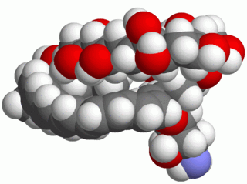
Comparative Genomics
L. mex. M379 wt progenitor
Increase Dose
Amphotericin B
X ~25
X ~25
L. mexicana M379 wt
L. mexicana M379 AmpB-R

Slide 3
Chromatography-Mass Spectrometry Workflow
Obtain Raw Data
Quality Control
Convert to mzXML
Pick Peaks
Filter (Group) Peaks
Annotate Peaks
Apply Stats
Interpret

Slide 4
Metabolome Scale Data
Wild-Type
Raw Data
300MB/file
Drug-Resistant
Features detected
50,000
Peaks picked
5000
Peaks filtered
2000
Peaks ID’d/Annotated 1000
‘Interesting’ Peaks
100
Candidates
20

Slide 5
From raw data to information – how do we get there?
Quality Control / Quality Assurance
XCMS
MzMatch.R
IDEOM post processing
Interpretation

Slide 6
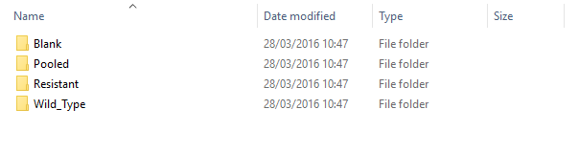
Setting up the analysis
Remaining commands run in R

Slide 7
Structure of a typical pipeline
setwd("J:/Data/Analysis_Name/analysis/Positive")
library (rJava)
library (mzmatch.R)
mzmatch.init (16000)
rawfiles <- dir (full.names=TRUE,pattern="\\.mzXML*",recursive=TRUE)
outputfiles <- paste(sub(".mzXML*","",rawfiles),".peakml",sep="")
for (i in 1:length(rawfiles)){xset <- xcmsSet(rawfiles[i], method='centWave', ppm=2, peakwidth=c(5,100), snthresh=3, prefilter=c(3,1000), integrate=1, mzdiff=0.001, verbose.columns=TRUE, fitgauss=FALSE)
PeakML.xcms.write.SingleMeasurement (xset=xset,filename=outputfiles[i],ionisation="positive",addscans=2,writeRejected=FALSE,ApodisationFilter=TRUE)}

Slide 8
Structure of a typical pipeline
MainClasses <- dir ()
dir.create ("combined_RSD_filtered")
dir.create ("combined_RSD_rejected")
dir.create ("combined")
for (i in 1:length(MainClasses)){FILESf <- dir (MainClasses[i],full.names=TRUE,pattern="\\.peakml$",recursive=TRUE)
OUTPUTf <- paste ("combined/",MainClasses[i],".peakml",sep="")
if(length(FILESf)>0){mzmatch.ipeak.Combine (i=paste(FILESf,collapse=","),v=T,rtwindow=30,o=OUTPUTf,combination="set",ppm=5,label=paste(MainClasses[i],sep=""))
RSDf <- paste ("combined_RSD_filtered/",MainClasses[i],".peakml",sep="")
REJf <- paste ("combined_RSD_rejected/",MainClasses[i],".peakml",sep="")
if(length(FILESf)>1) mzmatch.ipeak.filter.RSDFilter(i=OUTPUTf,o=RSDf,rejected=REJf,rsd=0.8,v=T) else file.copy(OUTPUTf,RSDf)}}
INPUTDIR <- "combined_RSD_filtered"
FILESf <- dir (INPUTDIR,full.names=TRUE,pattern="\\.peakml$")

Slide 9
Structure of a typical pipeline
mzmatch.ipeak.Combine(i=paste(FILESf,collapse=","),v=T,rtwindow=30,o="combined.peakml",combination="set",ppm=5)
mzmatch.ipeak.filter.NoiseFilter (i="combined.peakml",o="combined_noisef.peakml",v=T,codadw=0.8)
mzmatch.ipeak.filter.SimpleFilter(i="combined_noisef.peakml", o="combined_sfdet.peakml", mindetections=3, v=T)
mzmatch.ipeak.filter.SimpleFilter(i="combined_sfdet.peakml", o="combined_highintensity.peakml", minintensity=1000, v=T)
PeakML.GapFiller(filename = "combined_highintensity.peakml", ionisation = "positive", Rawpath = NULL, outputfile = "highintensity_gapfilled.peakml", ppm = 0, rtwin = 0)
mzmatch.ipeak.sort.RelatedPeaks (i="highintensity_gapfilled.peakml",v=T,o="mzMatch_output.peakml",basepeaks="mzMatch_basepeaks.peakml",ppm=3,rtwindow=6)
annot <- paste("relation.id,relation.ship,codadw,charge")
mzmatch.ipeak.convert.ConvertToText (i="mzMatch_output.peakml",o="mzMATCHoutput.txt",v=T,annotations=annot)

Slide 10
Checks
Should have Leish_WTvsKO.xls.
Open it.
Wait…
If anything doesn’t work, tell me now!

Slide 11
Session Objectives
By the end of this session you will be able to:
Evaluate the data from an IDEOM comparison sheet
Create graphs of specific metabolites
Create pathway maps with Pathos

